Slide 1
Rangama
A new Anagram game

Slide 2
Game Development Objectives
Utilize latest web development technologies
Collaborate as a team
Have fun!

Slide 3
Major Project Requirements
Use a Node and Express Web Server
Be supported by a MySQL database and an ORM interface
Use GET/POST connection routes
Deploy the app using Heroku
Apply a new library, package or technology
Demonstrate good quality coding practices including MVC folder structures

Slide 4
Game Purpose
Primarily a game for entertainment
A starting point for future enhancements such as multi-player versions, user accounts, rankings, avatars, and visual progress animations.
Potential educational use. Anagrams have been used in teaching reading.
Potential tool in psychological research. Anagrams have been used in studies.

Slide 5
Development Hurdles & Decisions
Decision on a application
Negotiation regarding extent of project scope
Merging code from multiple developers

Slide 6
Coding Plan-Front end
HTML/CSS
Anagram Node Package-retrieve list of anagrams
Match words entered to the anagram list
Generate new words
Keep track of score
Submit score

Slide 7
Coding Plan - continued
Back-end
Database
Request pre-existing word & anagrams from MySQL
On the fly response sending with total word score
Server correct pages with Express
Store pre-existing anagrams into the database
Store player score to db

Slide 8
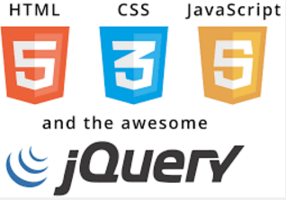
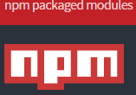
Technologies used:

